Slide 1
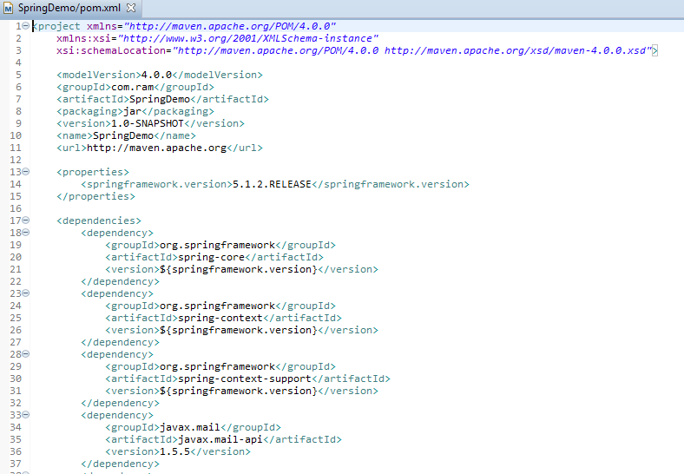
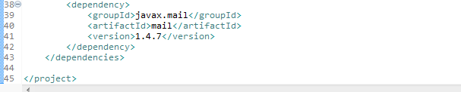
Spring Email With Inline Resource using Annotations
Spring Email support is built upon JavaMail API, which must be found on class path. In this example, we did so by including API javax.mail.javax.mail-api & implementation javax.mail.mail in our pom.xml. Spring’s EMail support related stuff is packaged under spring-context-support.

Slide 2
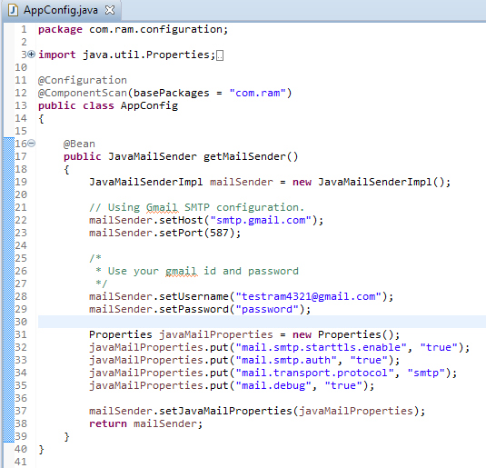
Spring Email With Inline Resource using Annotations
Spring comes with utility libraries which abstracts away the complexities of the underlying mailing system, provides super-simple API to use in your application to send emails
Spring provides two primary interfaces for sending emails:
MailSender : handy for sending simple mail messages, providing ‘from’,’to’,’cc’,’bcc’,’subject’ & other mail properties.
JavaMailSender : Extends MailSender, adds specialized JavaMail features such as MIME message support.
Spring’s JavaMailSenderImpl is production implementation of the JavaMailSender interface which can be used for host configuration as well as connection setup. Here is our configuration class, using Gmail SMTP connection settings to send emails using gmail.

Slide 3
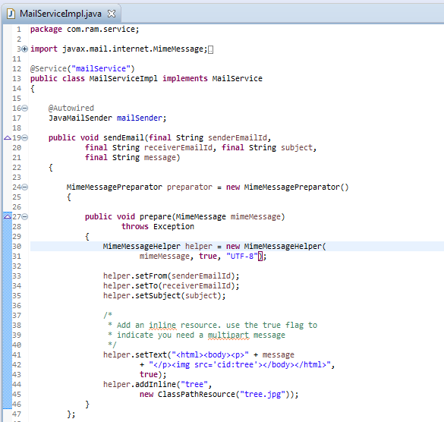
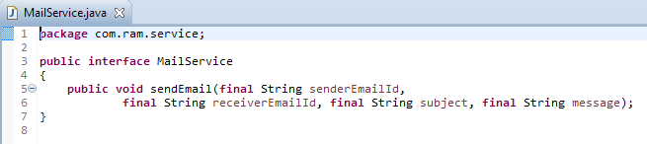
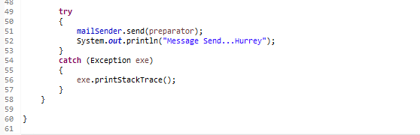
Spring Email With Inline Resource using Annotations
Spring’s org.springframework.mail.javamail.MimeMessagePreparator
Callback interface comes handy for the preparation of JavaMail MIME messages. We can use both MimeMessagePreparator & MimeMessageHelper to finally create a MimeMessage with inline content.

Slide 4
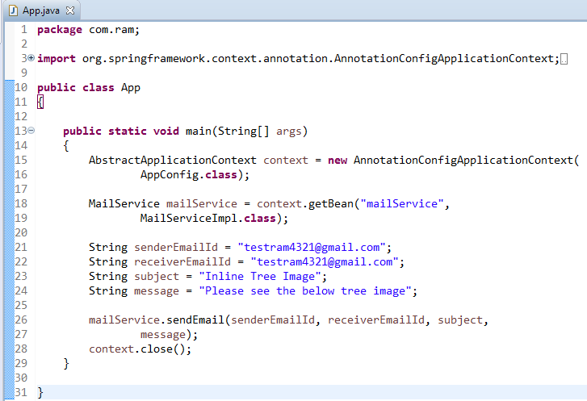
Spring Email With Inline Resource using Annotations

Slide 5
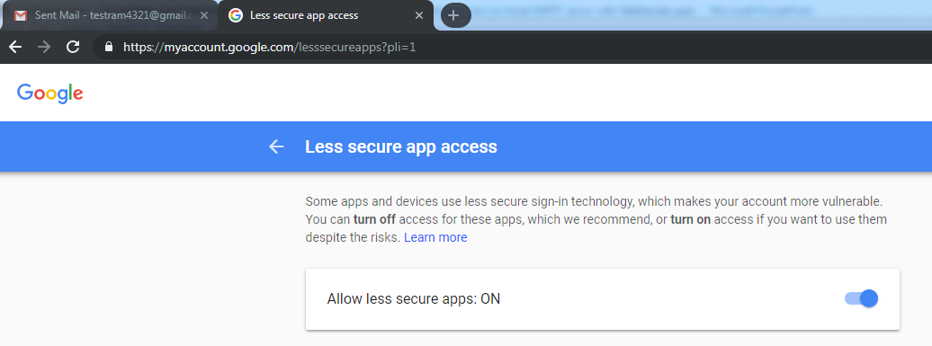
Spring Email With Inline Resource using Annotations
To resolve javax.mail.AuthenticationFailedException is thrown while sending email in java
Go Login from Your browser from that email. I had problem with google if it is google go here :https://www.google.com/settings/security/lesssecureapps
you will see turn off or turn on. Click "Turn on"
Then try your code again it will work

